Slide 1
JavaServer Pages (JSP)

Slide 2
Objectives
JavaServer Pages (JSP) introduction
  How JSP Works?
Basic tags
  Comment
  Directive
  Declaration
  Expression
  Scriplets
Implicit Objects
Action tags
Exception handling
<number>/26

Slide 3
JavaServer Pages (JSP)
JavaServer Pages (JSP) technology provides a simplified, fast way to create web pages that display dynamically-generated content.
JSP is an extension to Servlet, provides more functionality than servlet like EL, JSTL..
The JSP specification is an important part of the Java 2 Platform, Enterprise Edition.
The first place to check for information on JSP technology is https://www.oracle.com/java/technologies/jspt.html
Presentation layer for MVC architecture: separate the dynamic content of a Web page from its presentation
<number>/26

Slide 4
JSP introduction
  Middle-tier
  Presentation-tier
Web Server
(Servlet Container)
HTTP
JDBC
Database
Server
(3rd tier)
Browser
(client)
1st tier
Request
Servlet
Response
JSP
Request

Slide 5
JSP Page
JSP page consists of HTML tags and JSP tags. The JSP pages are easier to maintain than Servlet because we can separate designing and development.
A JSP page has the extension .jsp; this signals to the web server that the JSP engine will process elements on this page.
Pages built using JSP technology are typically implemented using a translation phase that is performed once, the first time the page is called. The page is compiled into a Java Servlet class and remains in server memory, so subsequent calls to the page have very fast response times.
<number>/26

Slide 6
Example
HTML tag
<HTML>
<HEAD><TITLE>MyFirstProgram.jsp</TITLE></HEAD>
<BODY>
<%-- MyFirstProgram.JSP -->
<%@ page import = "java.util.Date" %>
<% out.println("Hello there!"); %> <Br>
<%= "Current date is " + new Date() %>
</BODY> </HTML>
Comment
JSP Directive
JSP Scriptlet
JSP Expression

Slide 7
How JSP Works?
User Request – JSP File Requested
Server
File
Changed
Create Servlet from JSP
Translation
Servlet Compile
Execute Servlet
<number>/26

Slide 8
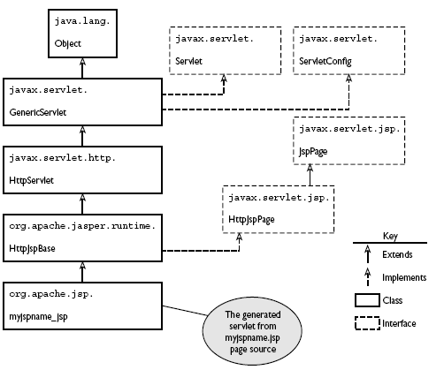
Class Hierarchy Generated Servlet
<number>/26

Slide 9
JSP Lifecycle
jspInit()
Servlet from JSP
Init Event
jspService()
Request
Response
jspDestroy()
Destroy Event
<number>/26

Slide 10
HTML Comment
Generates a comment that is sent to the client.
  Syntax
  <!-- comment [ <%= expression %> ] -->
  Example:
<!-- This page was loaded on
  <%= (new java.util.Date()).toLocaleString() %>
  -->
<number>/26

Slide 11
JSP Directives
Directives are used to control how the web container translates and executes the JSP page
Directives have attributes that dictate their meaning and effect. In almost all cases, the effects produced by directives can’t be replicated using expressions, scriptlets, or declarations.
We’ll consider the three directives:
  page,
  include,
  taglib.
<number>/26
Notes:
Taglib: https://openplanning.net/10429/java-jsp-standard-tag-library

Slide 12
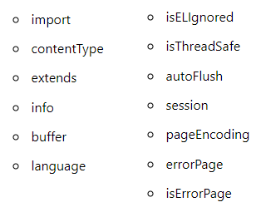
The page Directive
  The page directive defines attributes that apply to an entire JSP page
  <%@ page attributeName=“value" %>
Page attribute
<number>/26

Slide 13
The page Directive
  import to create import statements in the generated servlet source produced at translation phase.
  import=“java.util.*,model.*”
contentType is a String that specifies the MIME type of the response to be sent back. The default value is "text/html;charset=ISO-8859-1"
contentType=“text/html;charset=UTF-8”
pageEncoding set the character encoding of the page source.
pageEncoding=“UTF-8”
buffer sets the buffer size in kilobytesThe default size of the buffer is 8Kb.
<number>/26

Slide 14
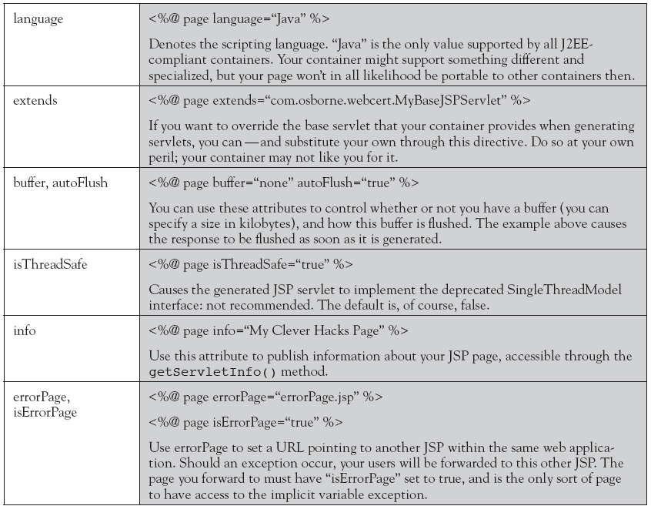
Other attributes of the page directive
<number>/26

Slide 15
The include Directive
A JSP source file and the pages it includes through the include directive are collectively referred to as a “translation unit.”
The file type you include doesn’t have to be JSP page source, nor does it have to have a .jsp extension. Once included, the file contents must make sense to the JSP translation process, but this gives scope to include entire HTML or XML documents, or document fragments.
Defining Implicit Includes with JSP property group
<number>/26

Slide 16
The include Directive…
<%@ include file=“relativeURL " %>
<html>
<body>
<%@ include file="header.jsp" %>
<h1>Including Page</h1>
<%@ include file="footer.html" %>
</body>
</html>
The taglib directive makes custom tags available in the JSP page by referencing a tag library
<number>/26

Slide 17
JSP property group
Defining Implicit Includes with JSP property group in web.xml
<jsp-config>
<jsp-property-group>
<url-pattern>*.jsp</url-pattern>
<include-prelude>/header.jsp</include-prelude>
<include-coda>/footer.jsp</include-coda>
</jsp-property-group>
</jsp-config>
<number>/26

Slide 18
JSP scripting elements
Scripting elements are inserted into the JSP page’s servlet class
Declarations
  <%! Member variable and method of servlet %>
Expressions
  <%= expression%>
Scriplets
<% java code %>
<number>/26

Slide 19
Declaration
Declares variable or method valid in the scripting language used in the JSP page.
  Syntax
  <%! declaration; [ declaration; ]+ ... %>
  Examples
  <%! String destin; %>
  <%! public String getDestination()
  {return destin;}%>
  <%! Circle a = new Circle(2.0); %>
  You can declare any number of variables or methods within one declaration element, as long as you end each declaration with a semicolon.
  The declaration must be valid in the Java language.
  variable or method declared are members of servlet generated
<number>/26

Slide 20
Expression
Contains an expression valid in the scripting language used in the JSP page.
  Syntax
  <%= expression %>
  Example
  <%! String name = new String(“JSP World”); %>
  <%! public String getName() { return name; } %>
  <B><%= getName() %></B>
  Description:
  An expression element contains a scripting language expression that is evaluated, converted to a String, and inserted where the expression appears in the JSP file.
  Because the value of an expression is converted to a String, you can use an expression within a line of text, whether or not it is tagged with HTML, in a JSPfile. Expressions are evaluated from left to right.
  Code generated into service() method of the translated servlet
<number>/26

Slide 21
Scriptlet
Contains a code fragment valid in the page scripting language.
  Syntax
  <% code fragment %>
  <%
  String var1 = request.getParameter("name");
  out.println(var1);
  %>
This code will be placed in the generated servlet method:
  _jspService()
  The use of scriptlet should be limited in JSP because JSP is mainly used for presentation
<number>/26

Slide 22
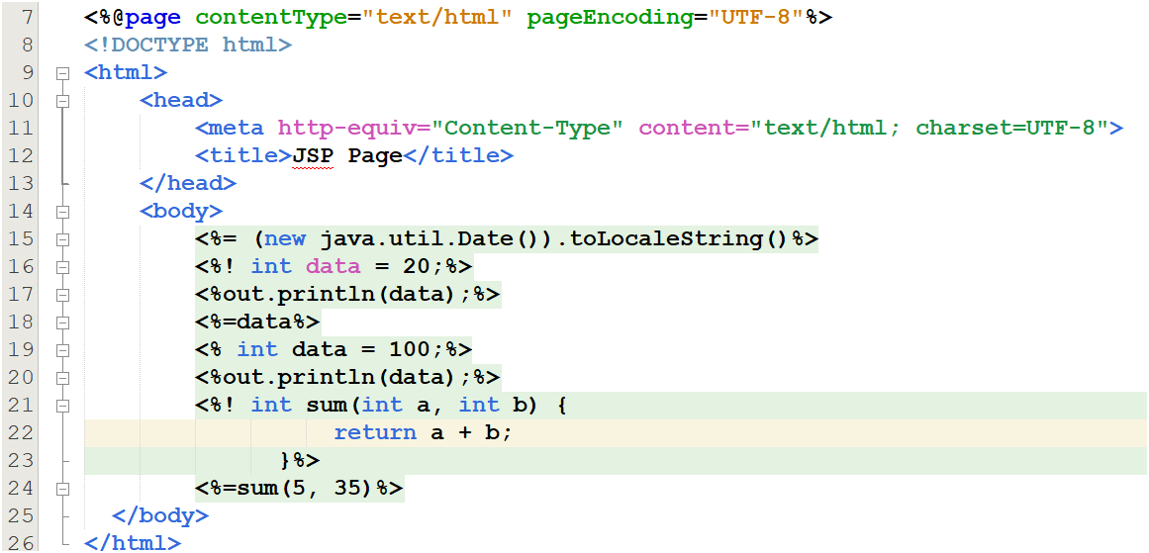
<number>/26

Slide 23
Predefined Variable – Implicit Objects
request – Object of HttpServletRequest (request parameters, HTTP headers, cookies
response – Object of HttpServletResponse
out - Object of PrintWriter buffered version JspWriter
session - Object of HttpSession associated with the request
application - Object of ServletContext shared by all servlets in the engine
config - Object of ServletConfig
pageContext - Object of PageContext in JSP for a single point of access
page – variable synonym for this object
https://www.javatpoint.com/request-implicit-object
<number>/26
Notes:
response – Object of HttpServletResponse=response.sendDirect: đóng vai trò là controller

Slide 24
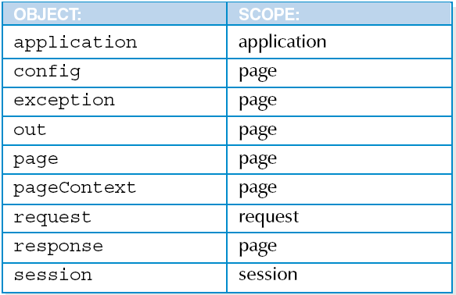
Predefined Variable – Implicit Objects
<number>/26
Notes:
https://ezse.net/javaweb/jsp/jspscopes.html#get-scriplet-variable

Slide 25
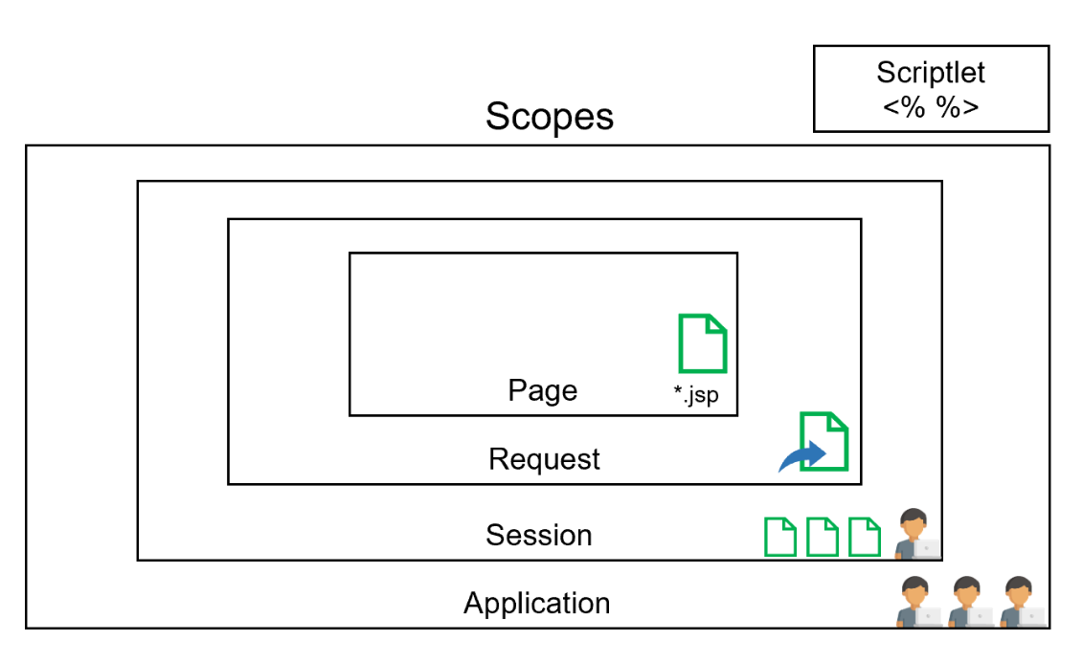
<number>/26

Slide 26
JSP Actions
Standard actions are used for the same purpose as Java language-based scripting: Most if not all the goals that you can achieve with standard actions are achievable with other scripting elements.
So why use them?
  The answer is that they get the job done more elegantly. They often provide an alternative to inserting java code into your neatly designed presentation page.
<number>/20

Slide 27
Standard actions general syntax
<prefix:tagname firstAttribute="value" secondAttribute="value">
...
</prefix:tagname>
<number>/20

Slide 28
Dispatching action <jsp:include>
The standard action <jsp:include> can be used to include the response from another page within your JSP page output.
You specify the file whose response should be included with the page attribute, like this:
<jsp:include page="pageToInclude.jsp" />
The file whose response should be included has to reside somewhere in your web application but doesn’t have to be present until the page is actually requested.
<number>/20

Slide 29
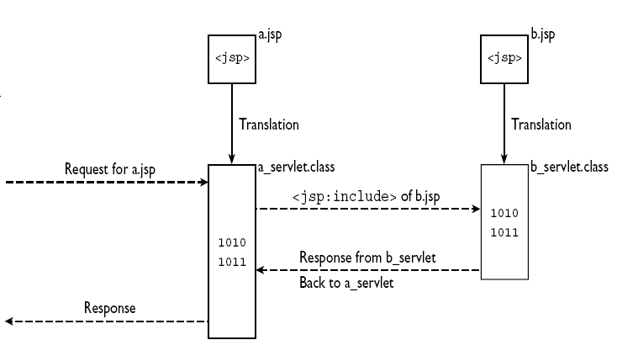
<jsp:include> vs. <%@ include %>
<jsp:include>
<number>/20

Slide 30
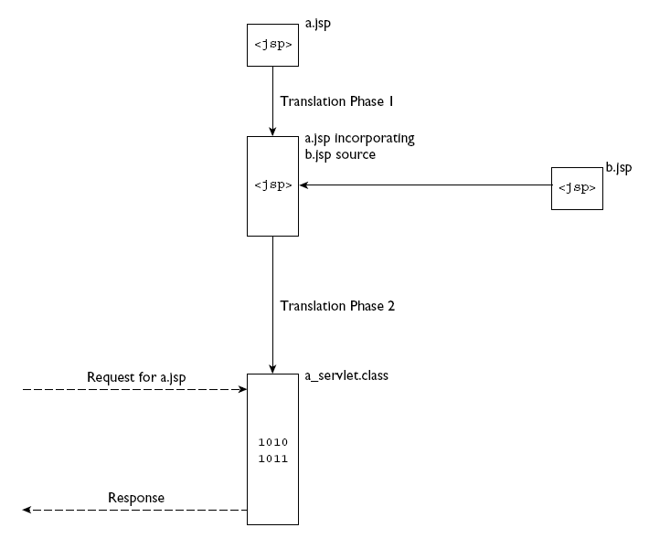
<jsp:include> vs. <%@ include %>
<%@ include %>
<number>/20

Slide 31
Dispatching action <jsp:forward>
The purpose of this standard action is to forward processing to another resource within the web application.
  <jsp:forward page=“destinationPage">
  <jsp:param name=“.." value=“.." />
  …
  </jsp:forward>
<number>/20

Slide 32
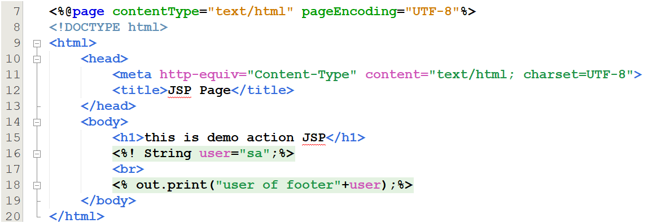
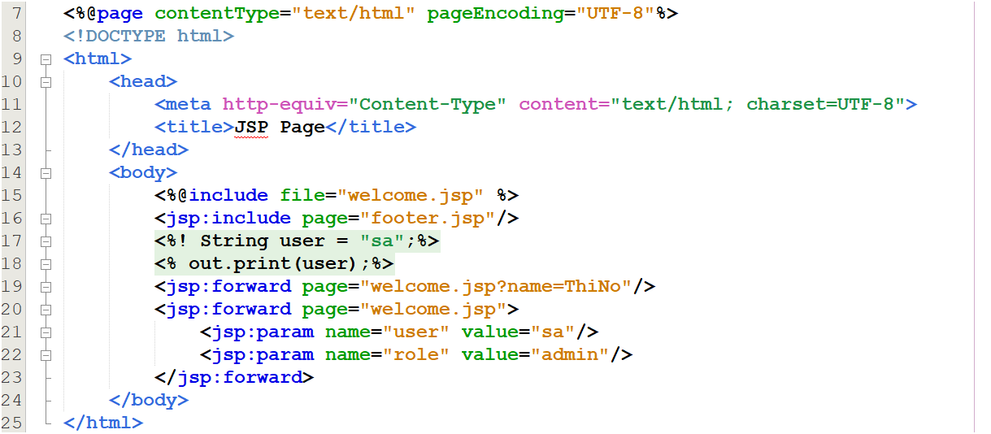
<number>/26

Slide 33
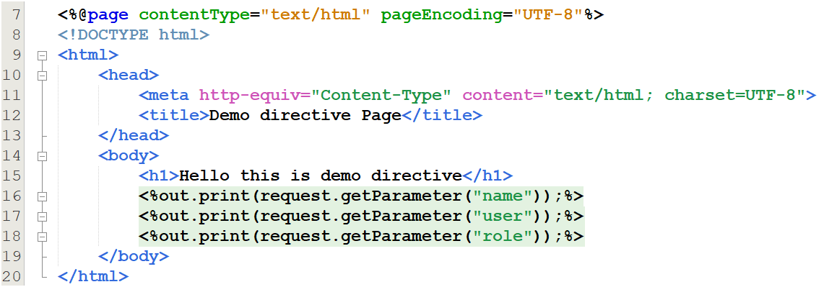
<number>/26

Slide 34
JSP exception handling
Translation and compilation errors
  Both the translation and the compilation phases can yield errors that are observed only when the page is requested for the first time.
  If an error is encountered during either phase, the server will return JasperException and a message that includes the name of the JSP page and the line where the error occurred.
Runtime Exception
  Occurs during serving request
  Catch by error page for specific exception
  Define error pages for the whole web app in web.xml

Slide 35
JSP exception handling
The page directive in JSP provides two attributes to be used in exception handling.
  errorPage: Used to site which page to be displayed when exception occurred
  isErrorPage : Used to mark a page as an error page where exceptions are displayed
  <%@page isErrorPage="true“ %>
  <%@page errorPage=“errorhandle.jsp“ %>
exception implicit object available only on error page
  use to send customized error message to the client.

Slide 36
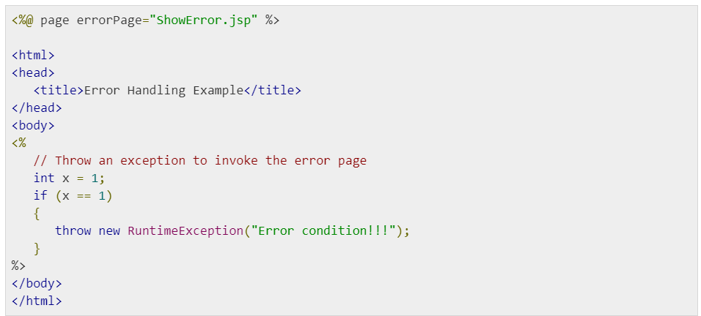
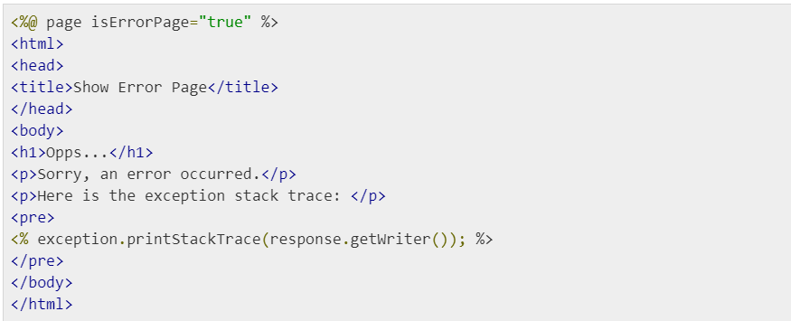
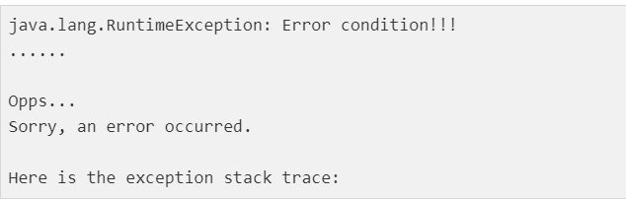
<number>/26

Slide 37
Summary
JavaServer Pages (JSP)
  Presentation tier
  JSP Page
  How JSP Works?
  JSP Lifecycle
  JSP Tags
  JSP Implicit Objects
  JSP Action
  JSP error handling
<number>/26

Slide 38
Constructive question
Why should you limit the use of scriptlets in JSP?
Design views for customer registration of a web application.
How will the JSP page meet the needs of multiple concurrent users?
Compare 2 variables declared by declaration tag and by scriptlet
Compare two include mechanisms using directives and actions
When you want to redirect users to login to their role-specific page, should use sendRedirect or action forward?
<number>/20

